Slide 1
Believe-Credu Project
Overview
Sharon Krause
January 2021

Slide 2
Outcomes
 | Target in 12 months | Actual total Dec 2020
No of women engaged in the project | 50 | 27
Employment Support | 40 | 15
Work placement | 20 | 9
Support to find employment | 16 | 12
Attended relevant training | 44 | 35

Slide 3
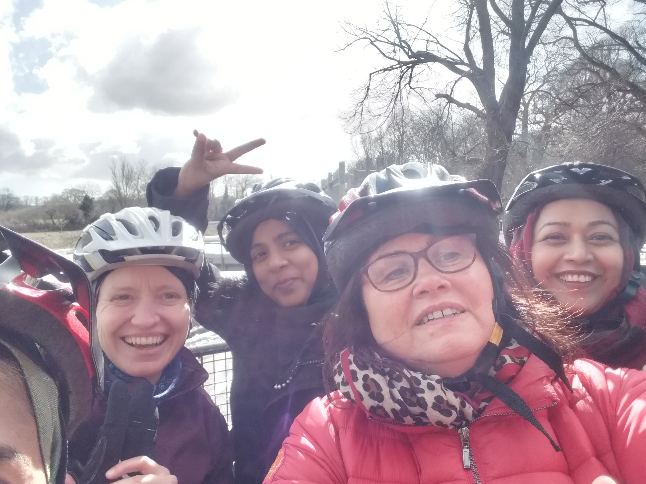
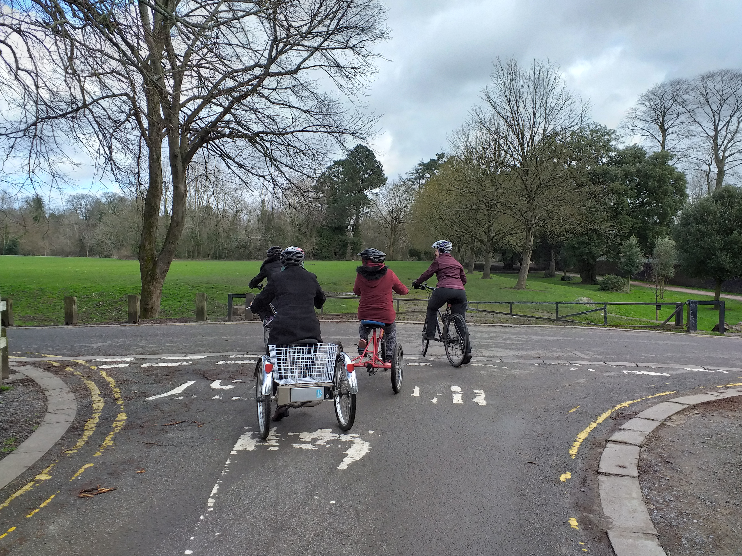
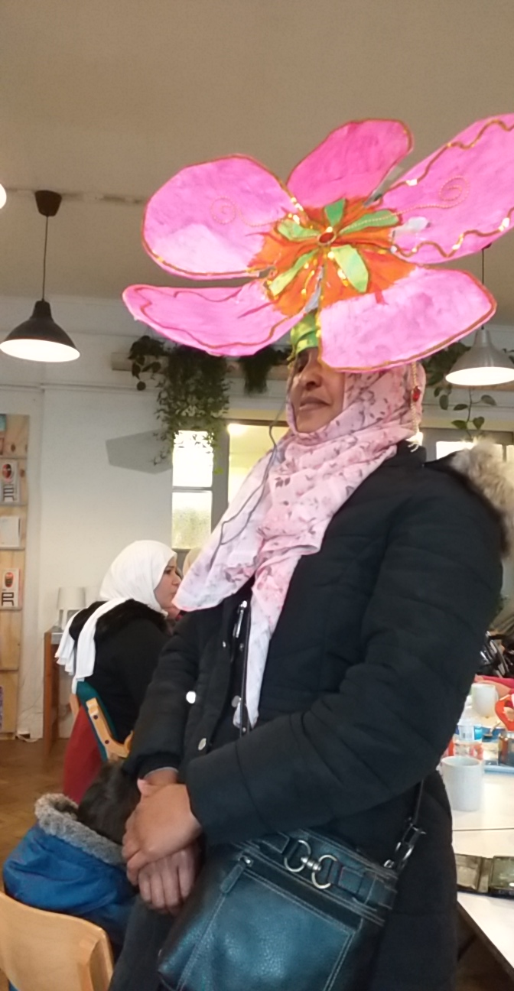
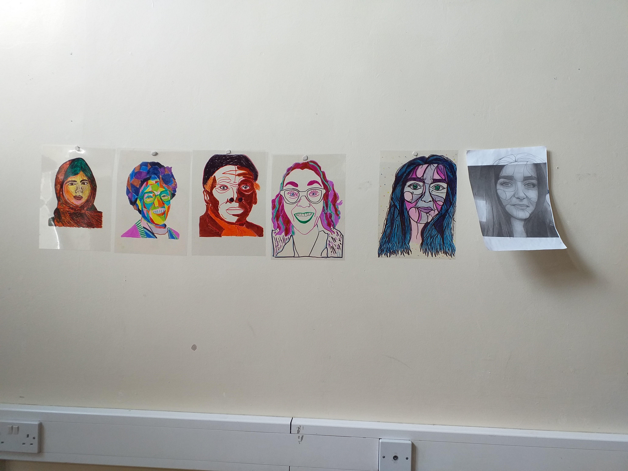
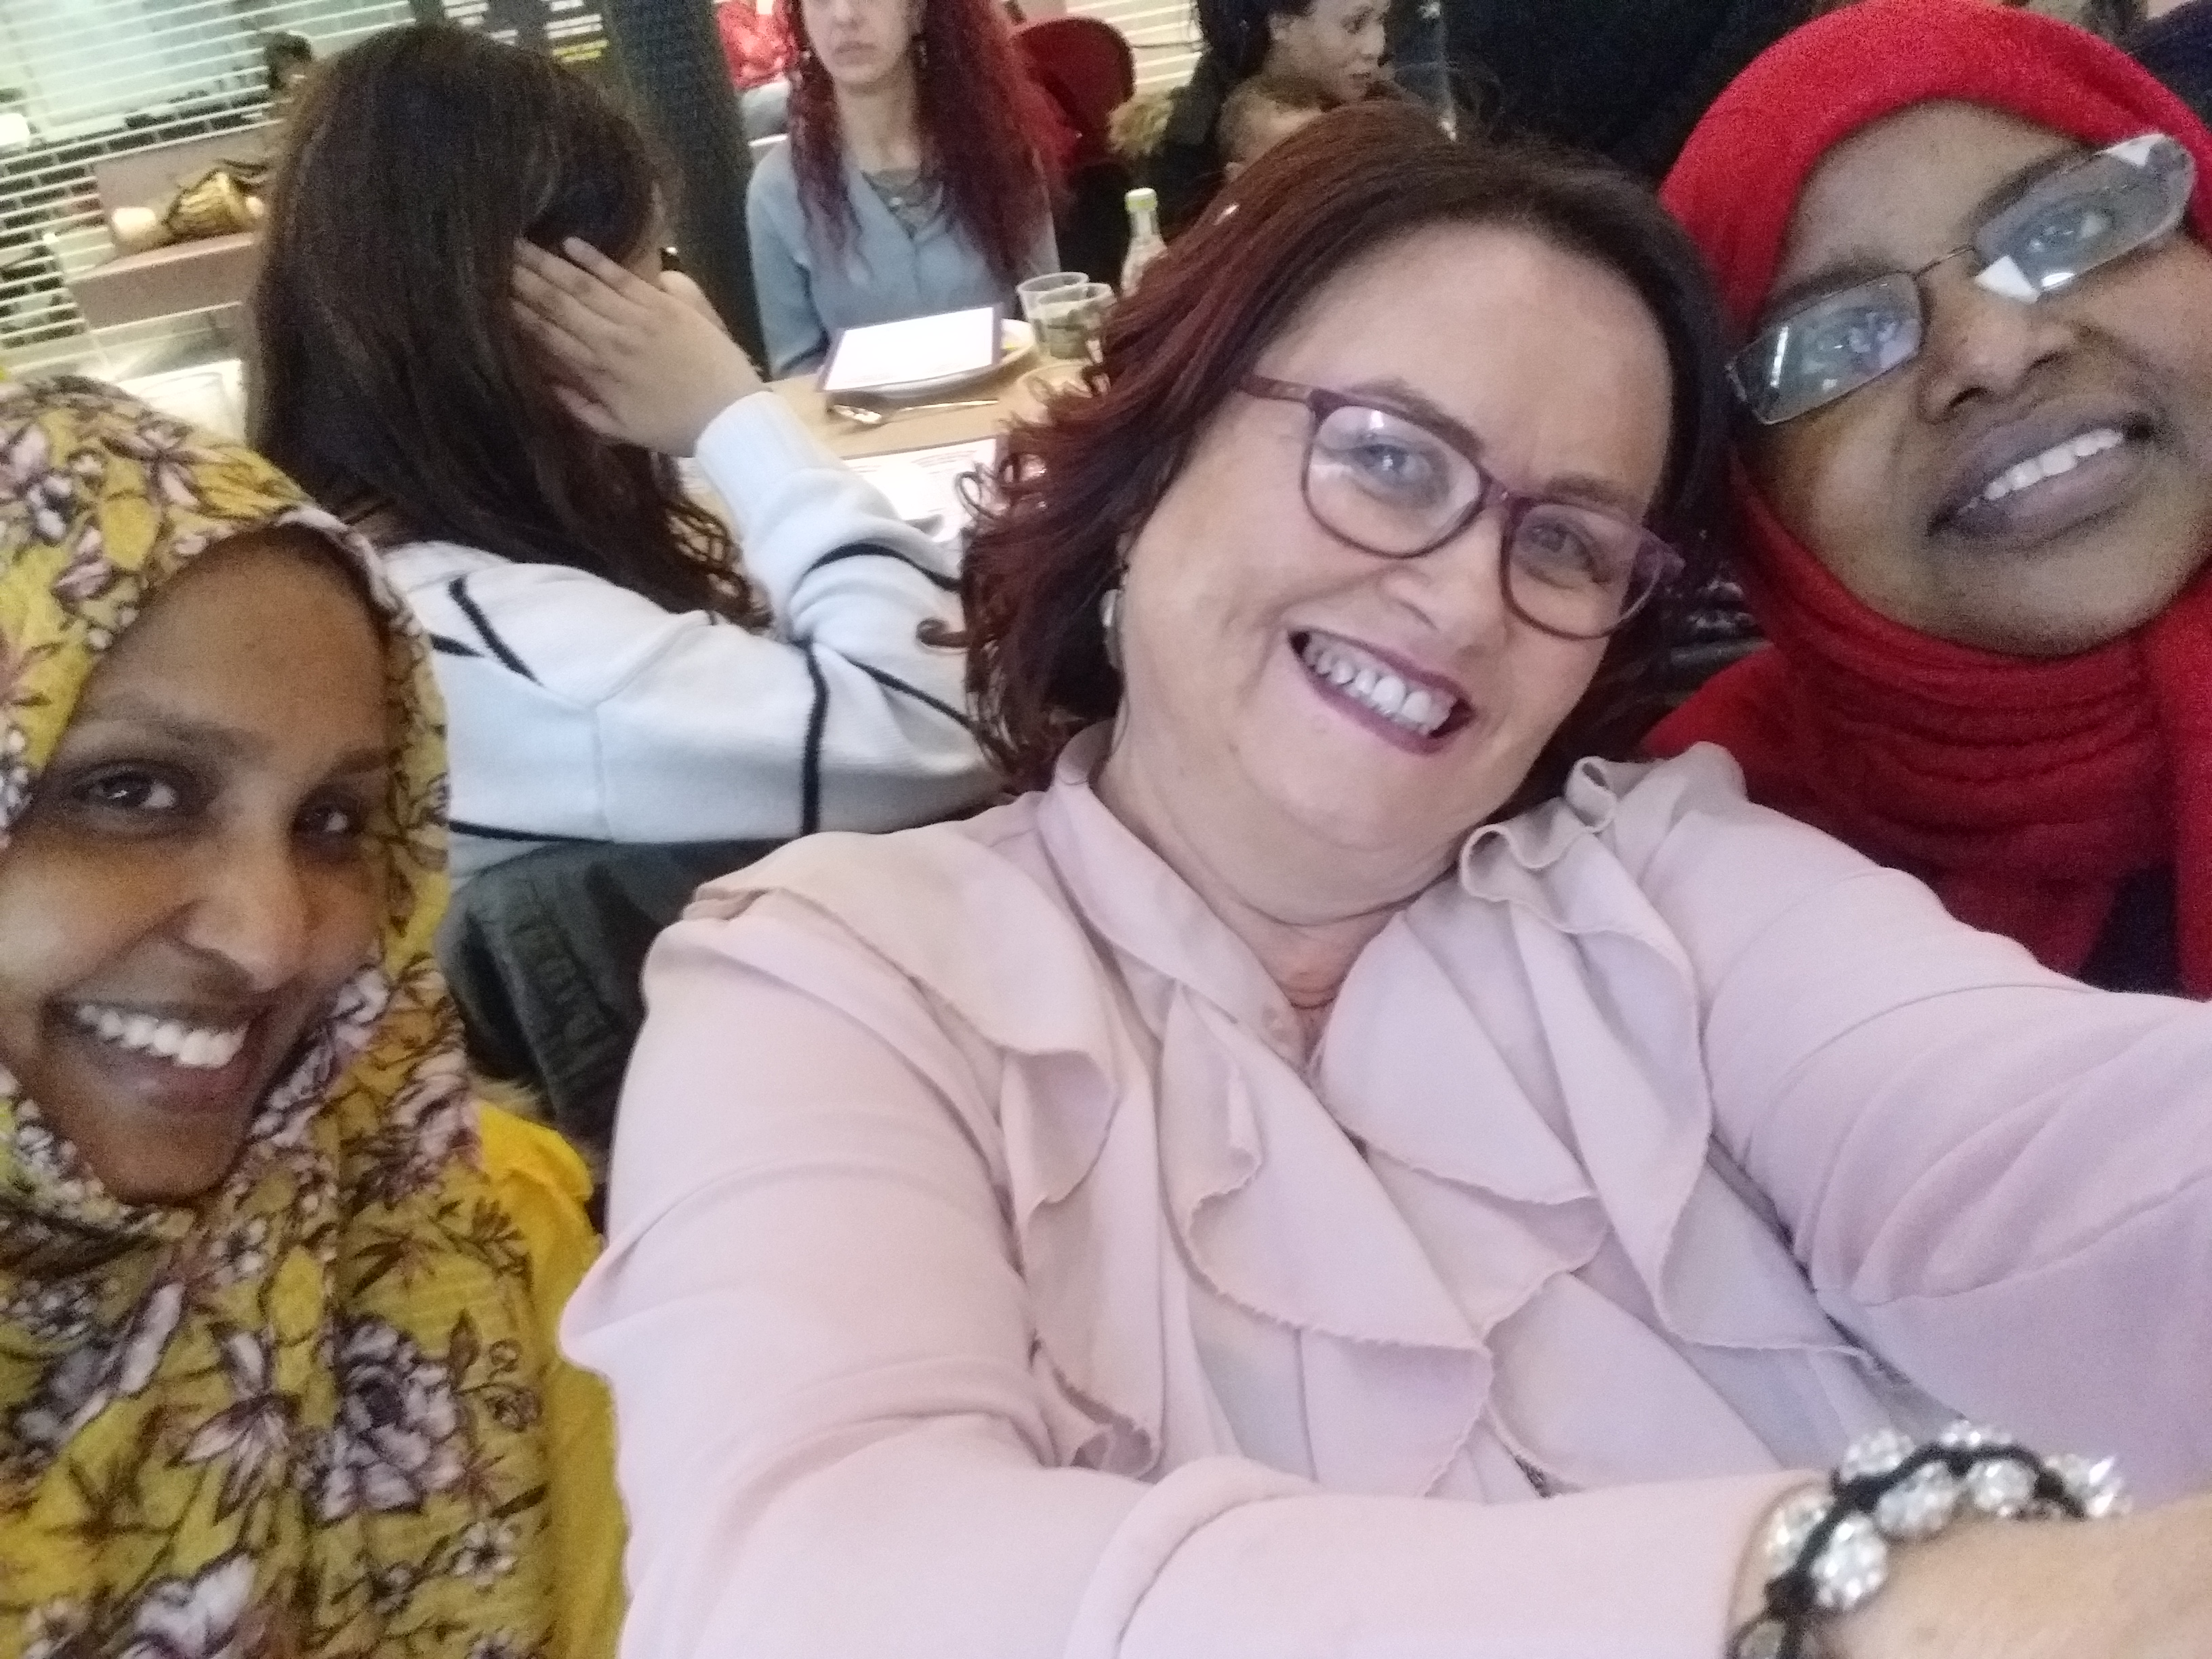


What does it actually look like ?

Slide 4
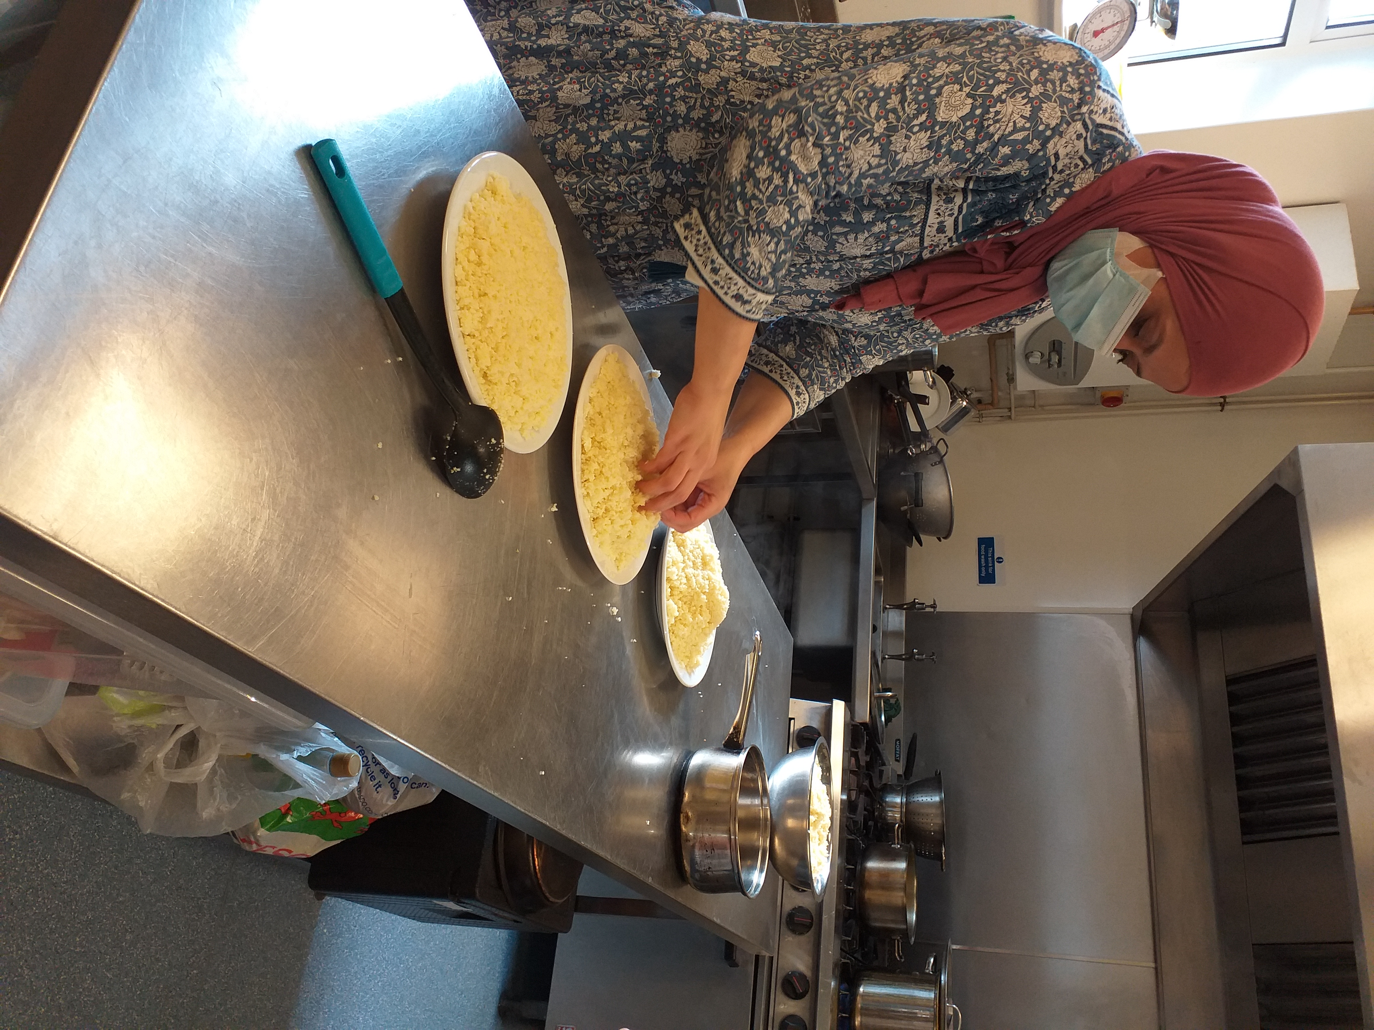
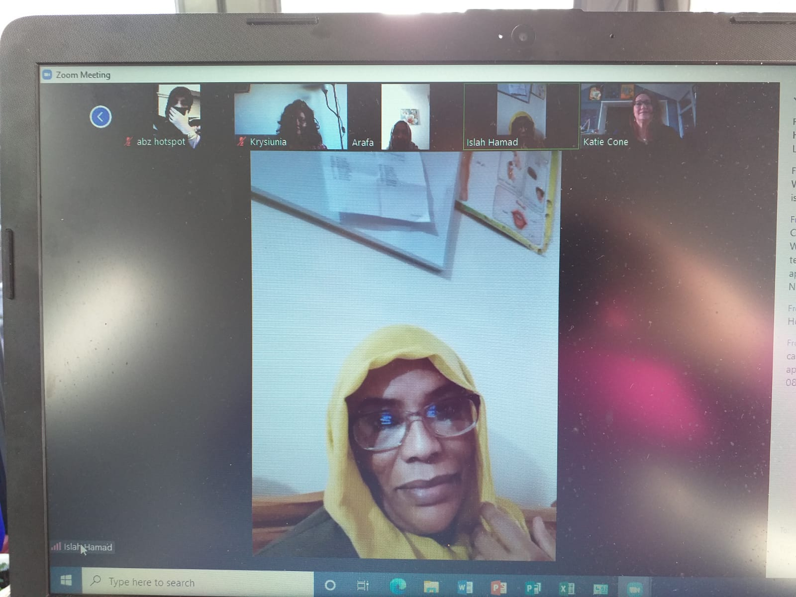
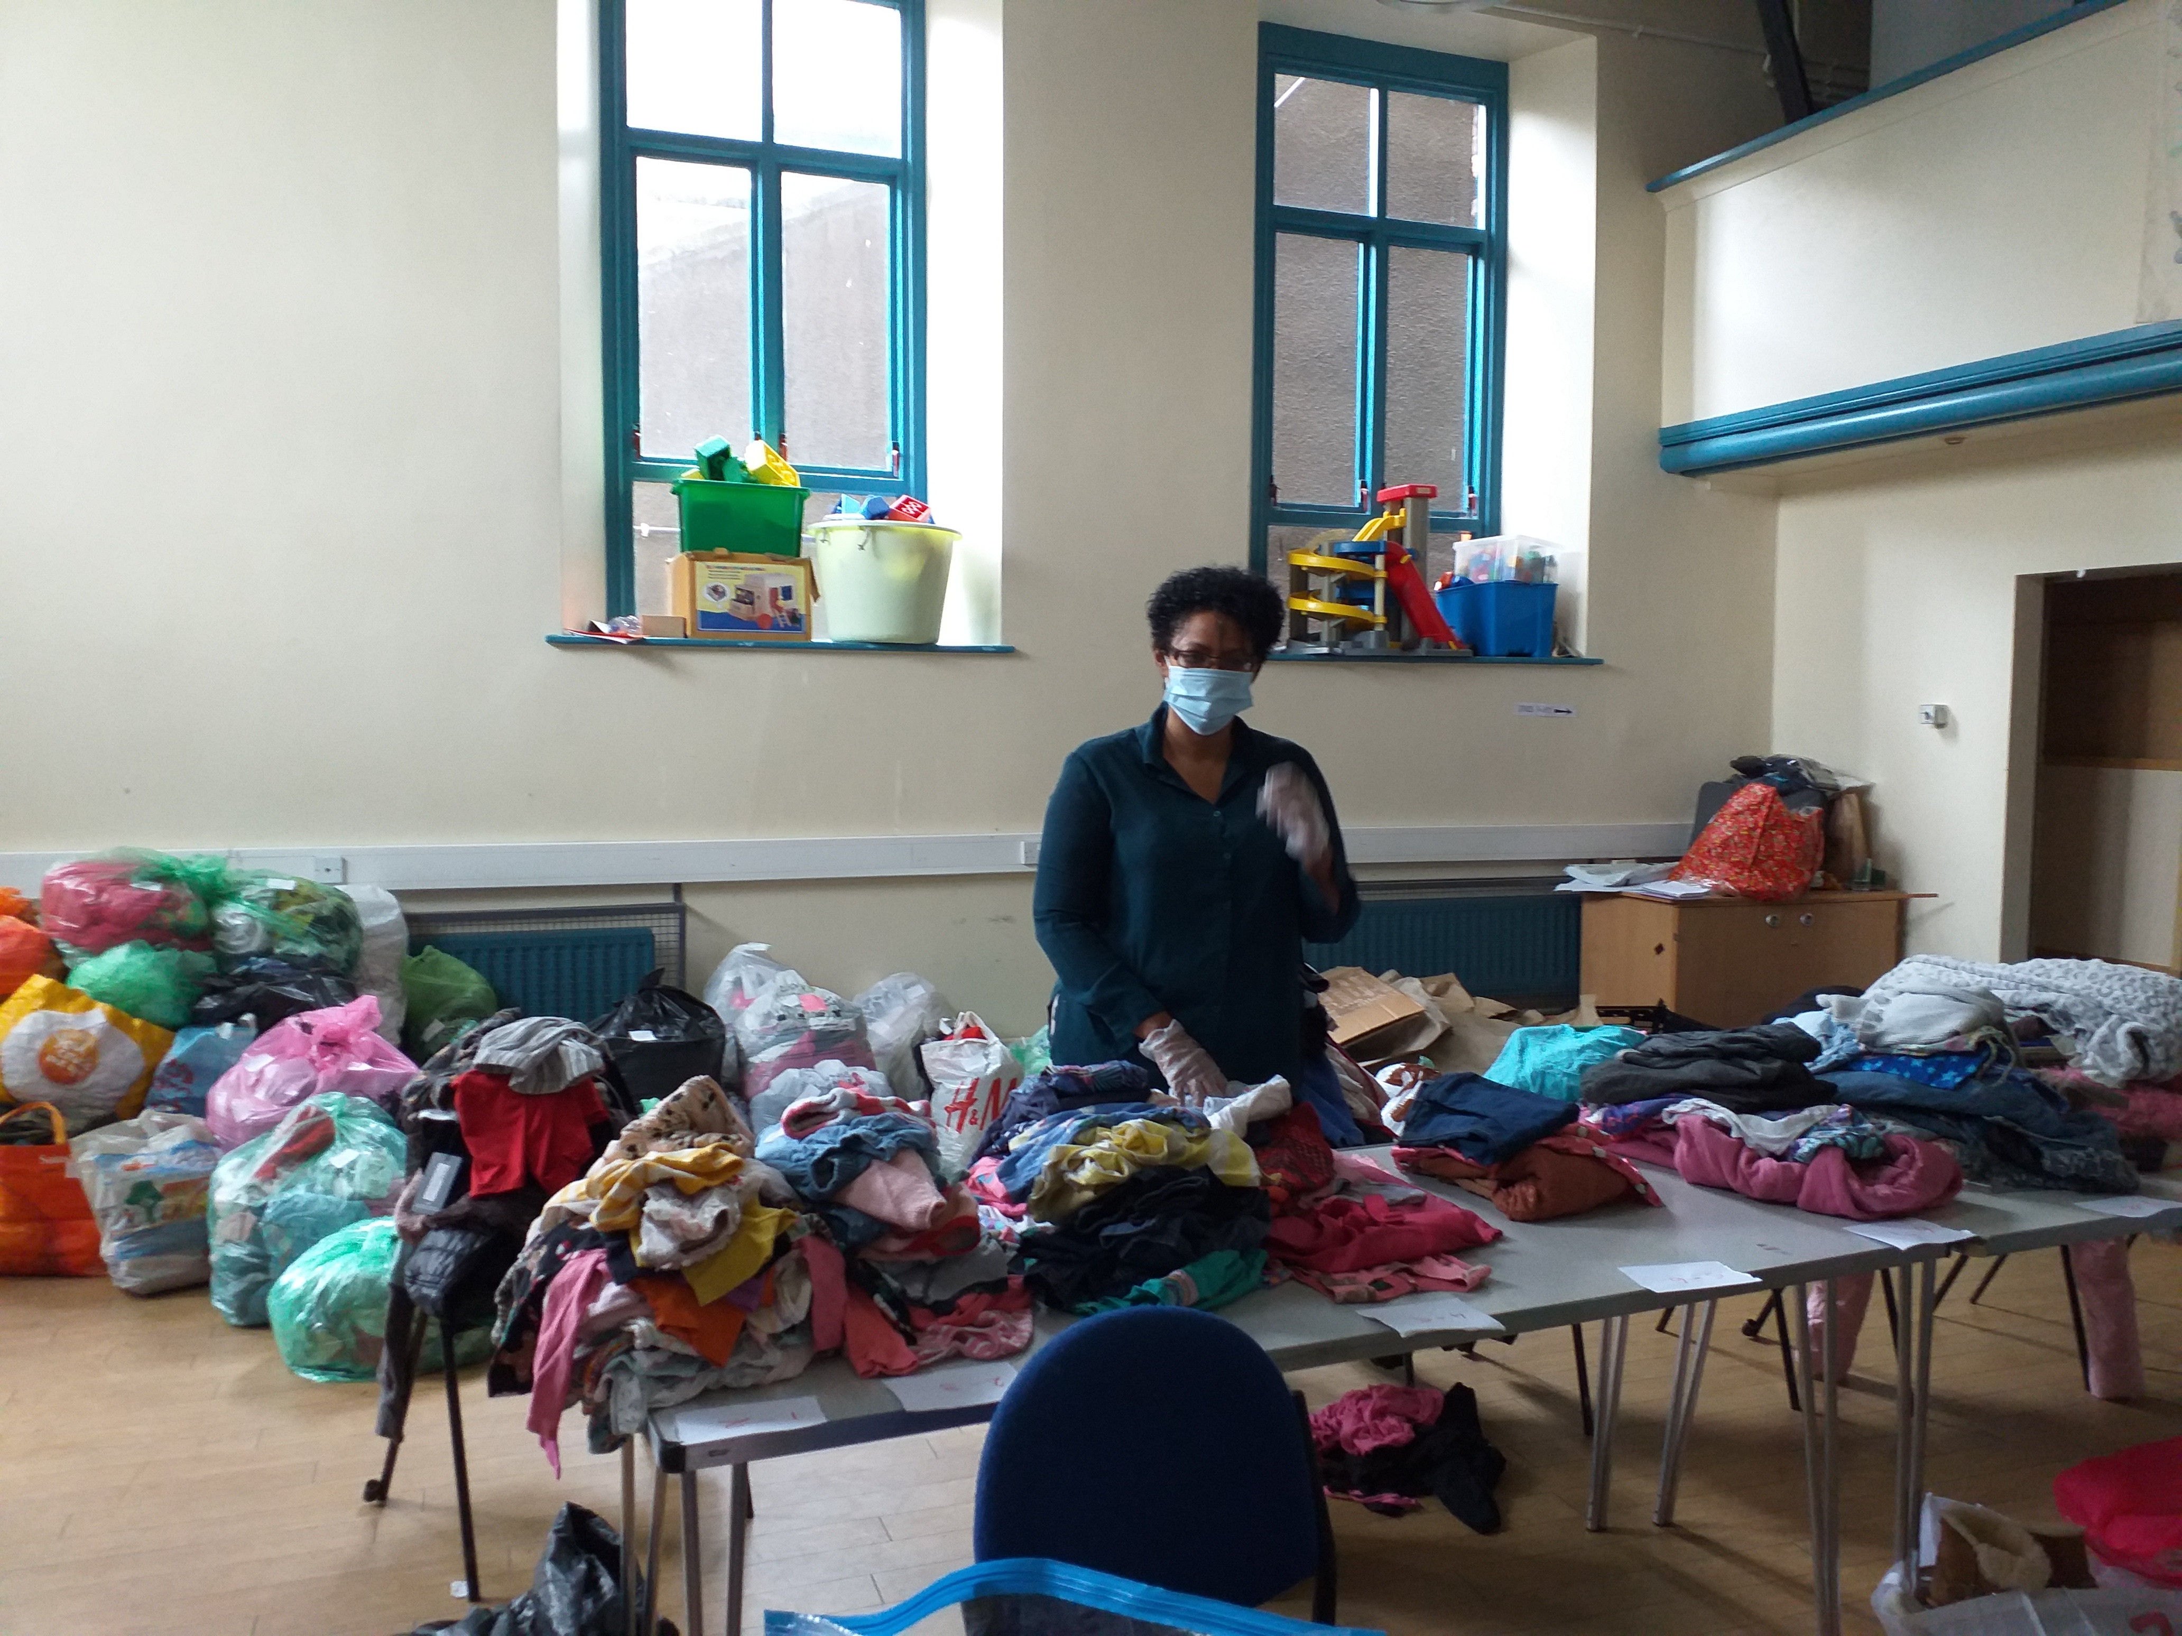
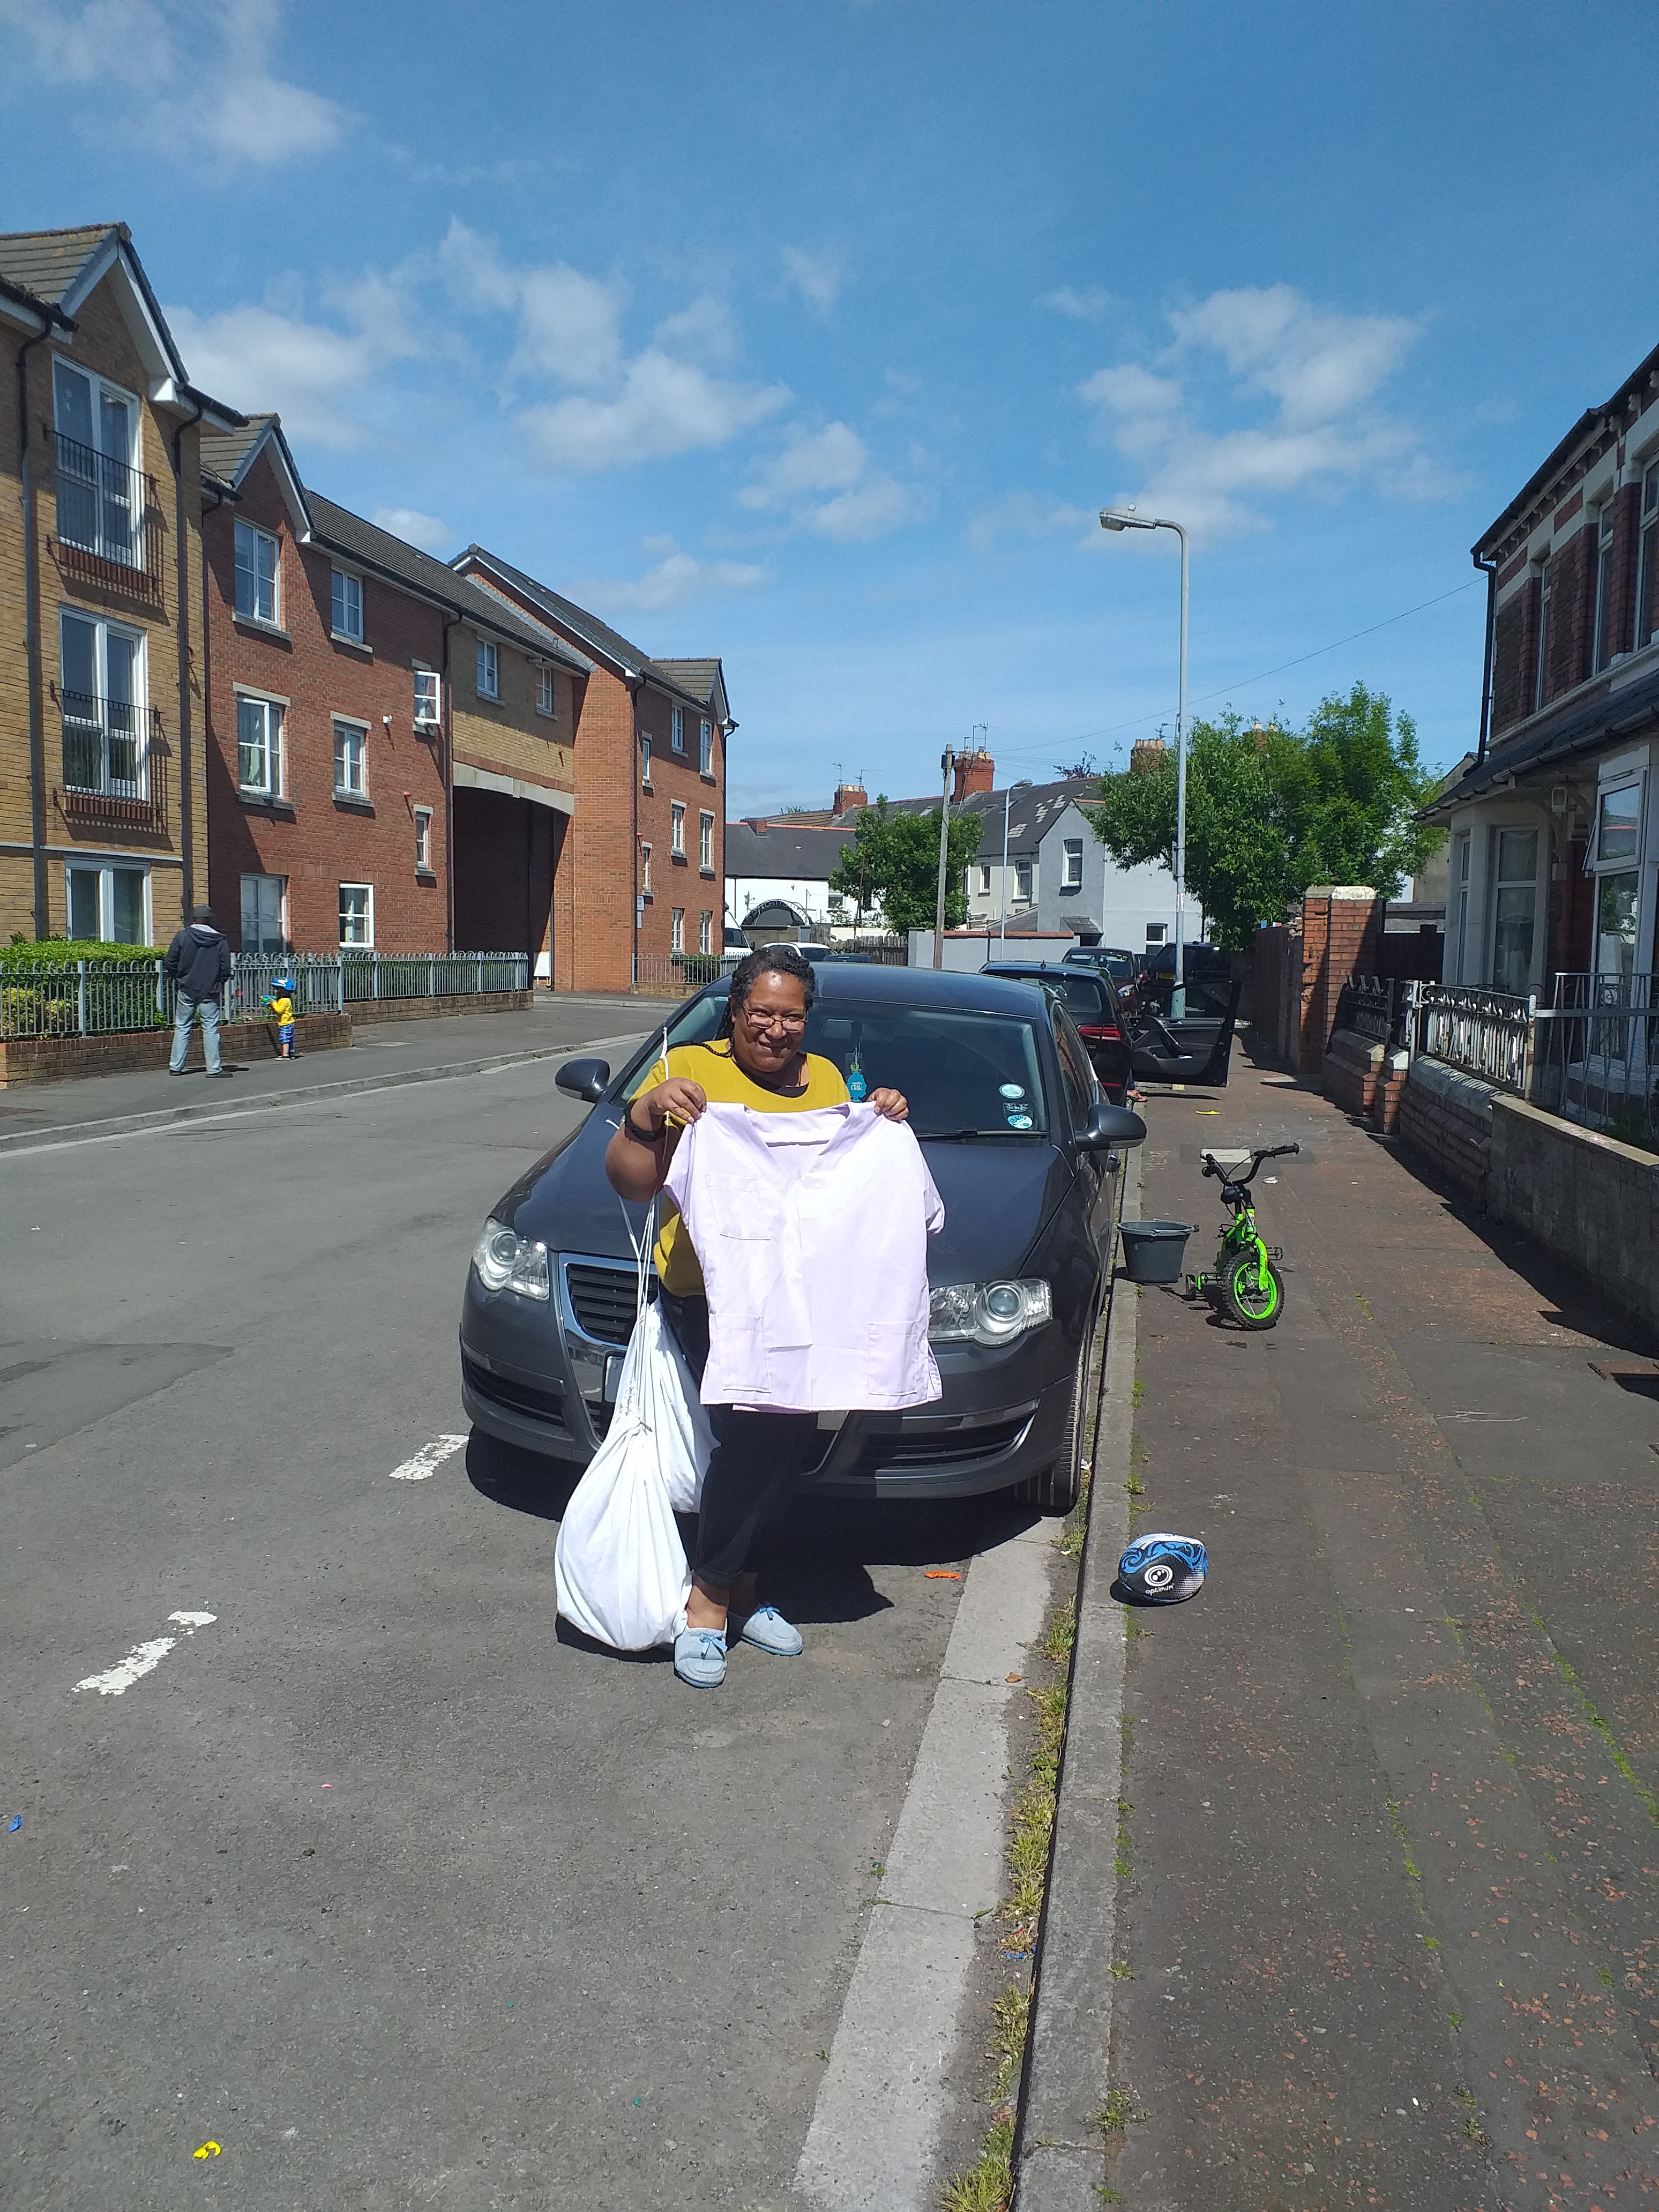
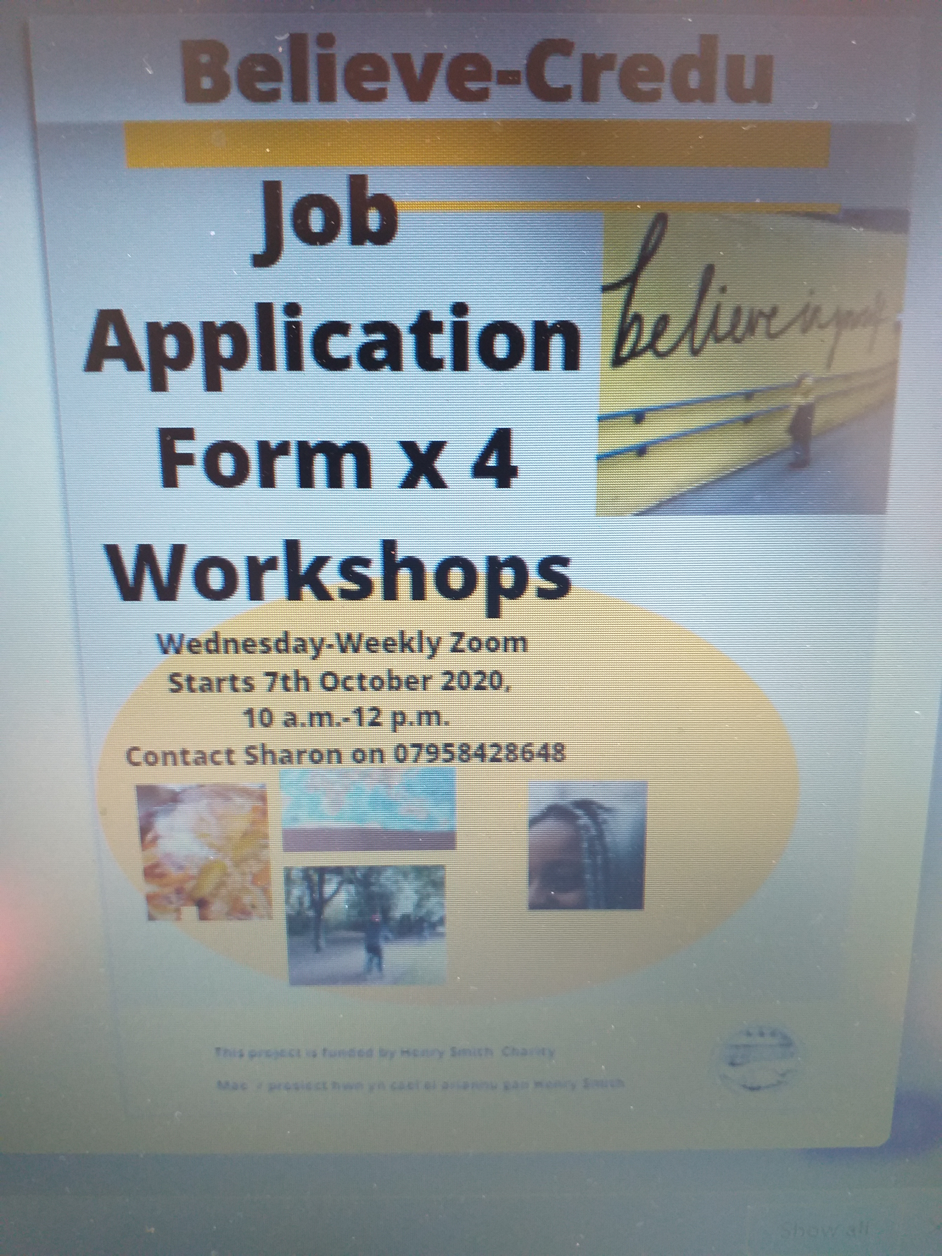
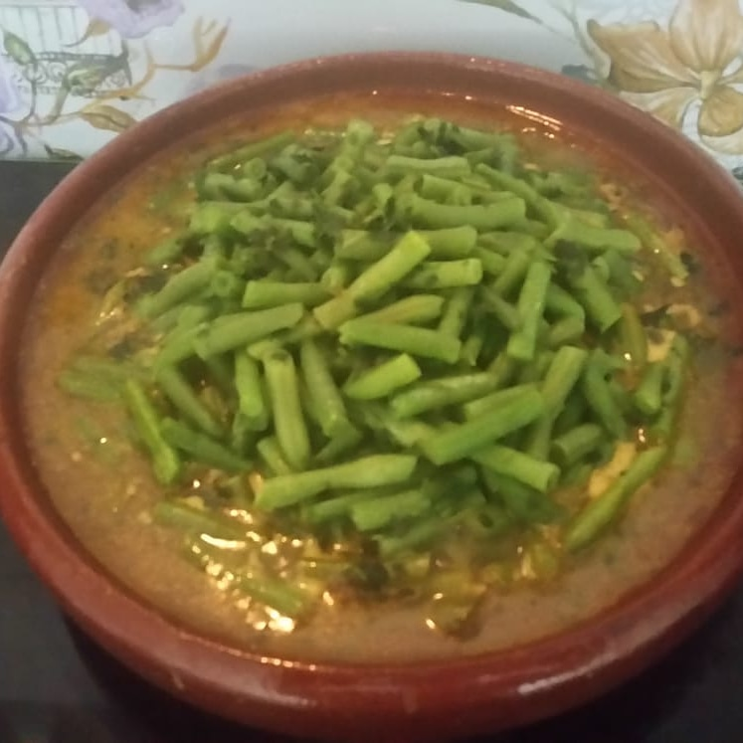
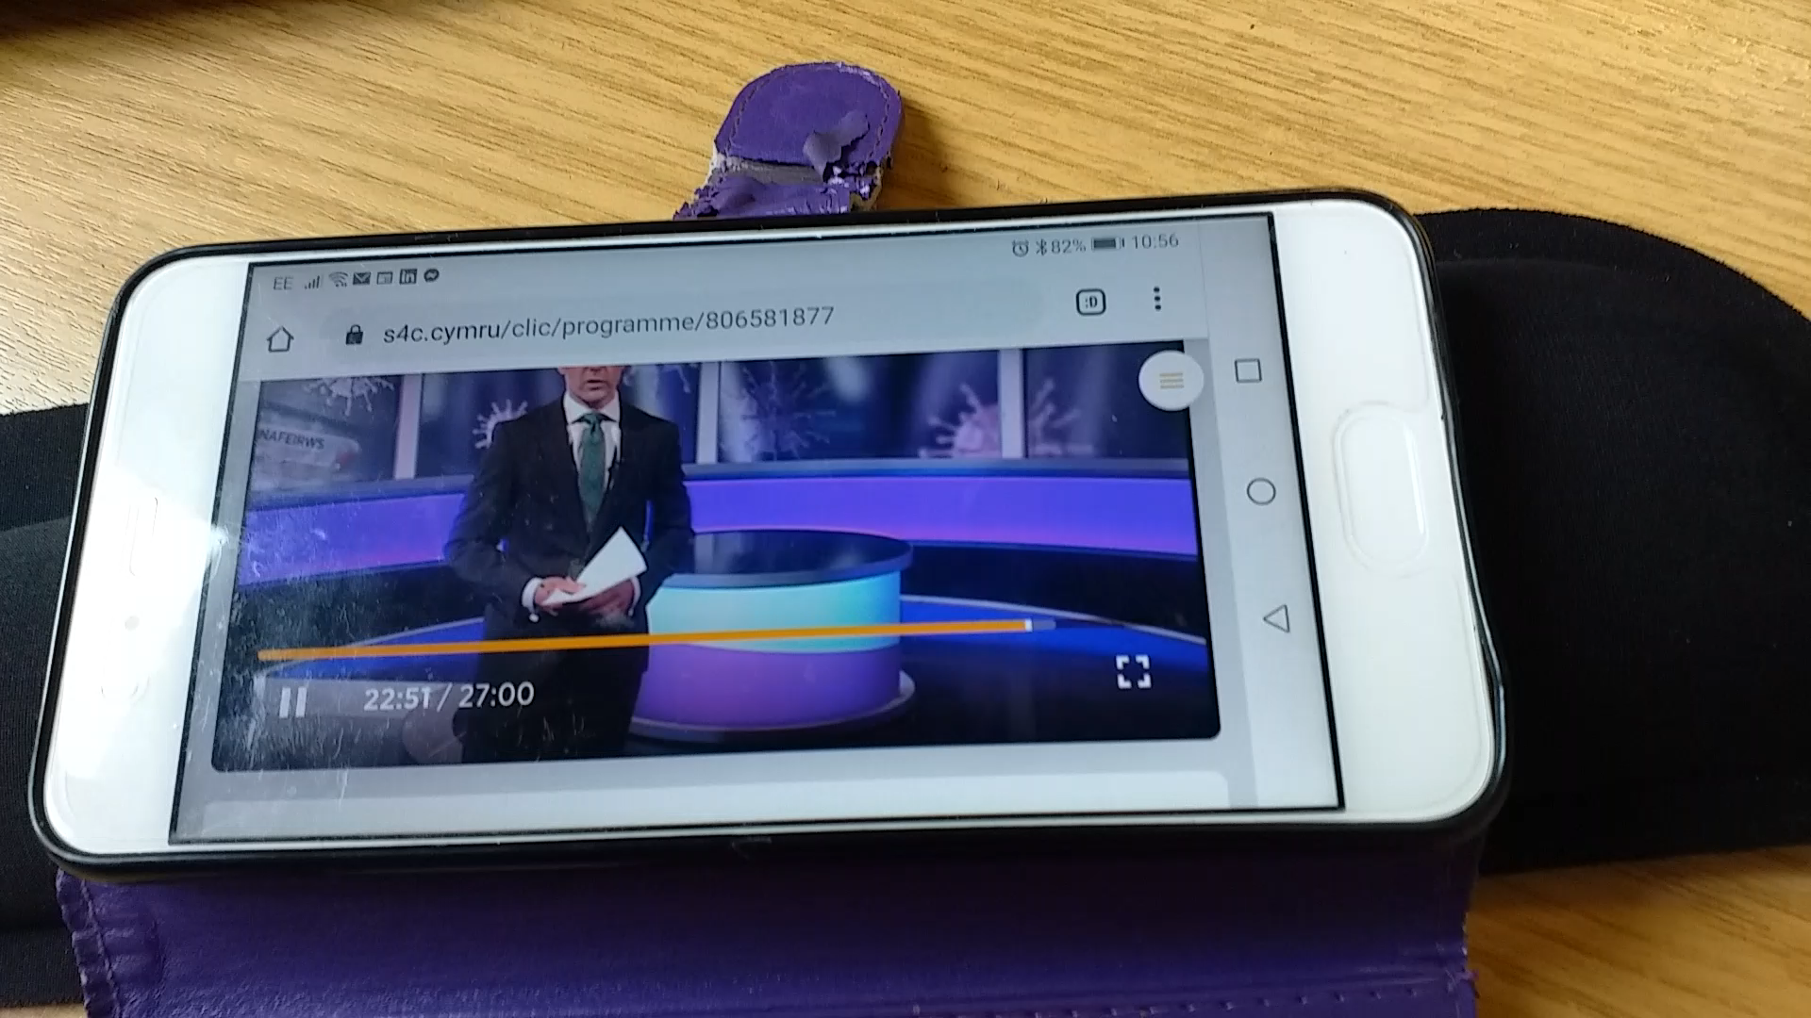
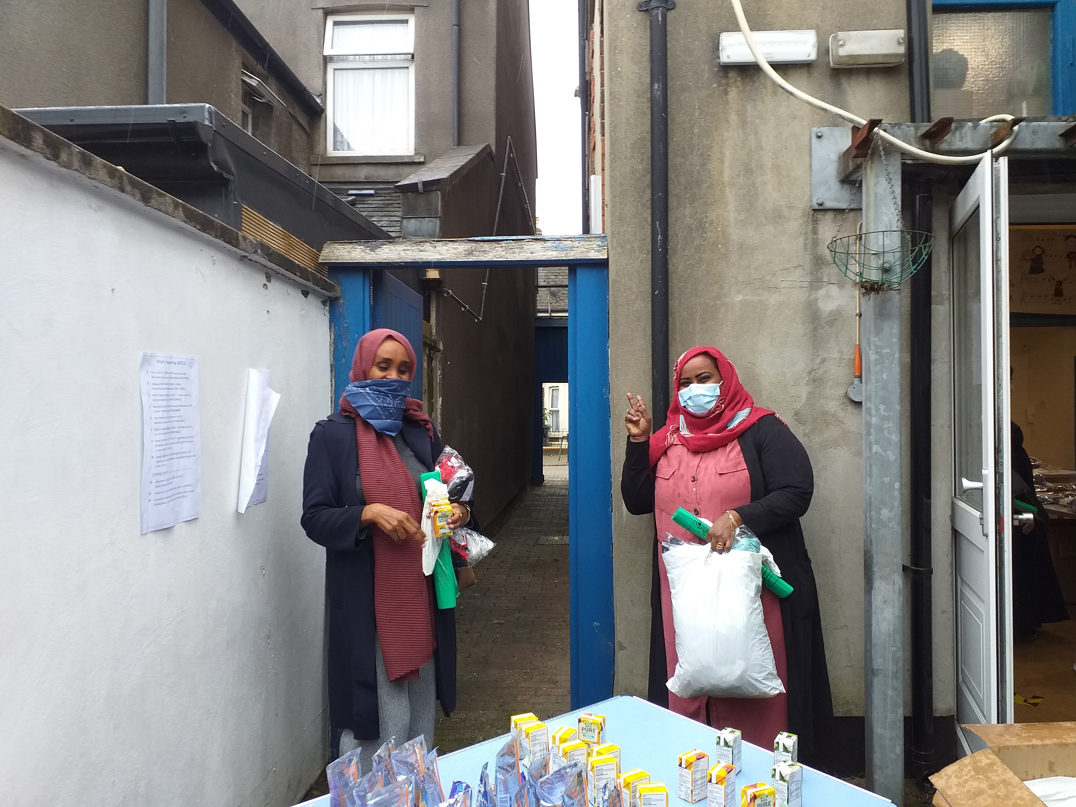
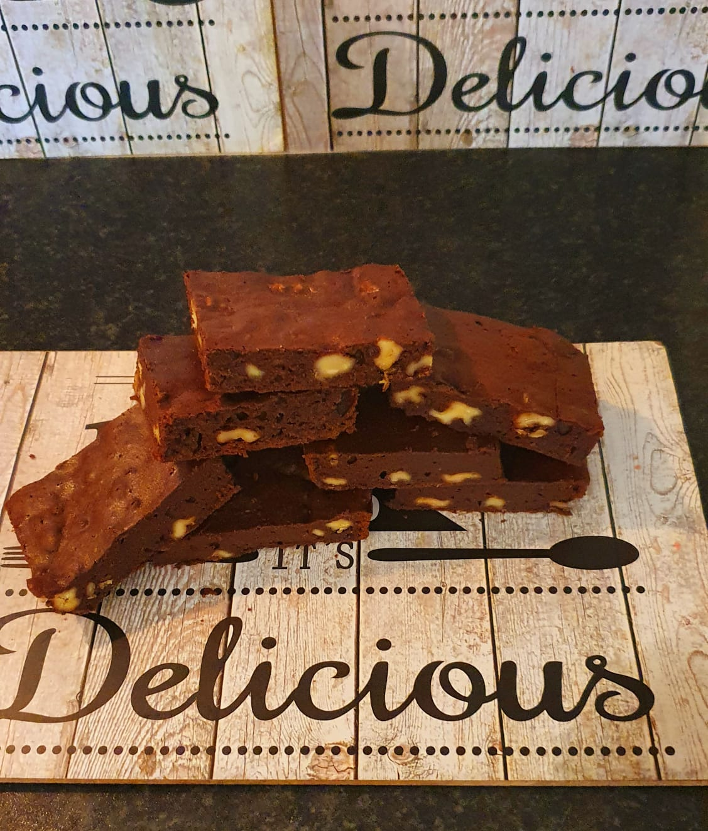
This is what it looks like

Slide 5
Challenges
Covid 19
Digital Literacy & Resources
Languages
Essential Skills
Child Care/Home schooling
Emotional & Mental Wellbeing

Slide 6
Good News Stories
Achieved
Ready, Steady Cook- A taste of Riverside.
Pedal4It - BAME-Breeze Cycle Leaders
Lets Interpret Post- courses completed.
Sewing Project Post
Info & Guidance Post
Go4Girls
B2
Riverside Robes-Clothes Project
Pantry-Volunteers.
Moving Forward
Recruit new Interpreters- Lets Interpret-Mentoring
Read & Write Group
Go4Girls
Interpreting & Health Course
Public Health Info-Funding Bid
Expanding Sewing Project to maybe include Repair Café & Benthyg Model.

Slide 7
Feedback
Positive feedback from Henry Smith about achievements and possible future funding.-Neil
Feedback from Clients.-”Thank you for your help” (LM) “Sometimes I have to pinch myself, because my life has changed so much” (RC), “Hi Sharon, how are you and family I just need to tell you I need your help cos my husband is sick , can you help me…….Thank you so, so much “. (MA)
“Thank you, you are a wonderful person and since I have met you, you have always supported me” (XR)
Steering Group-Despite the challenges of Covid Sharon has managed to deliver excellent outcomes.
Partners- Bore da Sharon
I would like to take this opportunity to say a big THANK YOU/DIOLCH YN FAWR IAWN for all your support with families over the last few months. The families that have received the clothing for their children are so very grateful for the generosity, flexibility and kindness shown during this difficult time. The families feedback has been so positive that they cannot thank you enough.
It is great to see professionals, communities and individuals working together to support one another during this difficult time and to show that we can work together in a positive way.
Thank you so much once again for going above and beyond to support families within communities.
I look forward to working with you again in the future.
Take Care/Cofion Cynnes
Erin Symons
Ymgynghorydd Cymorth Teulu/ Family Help Advisor
Cyngor a Chymorth i Deuluoedd Caerdydd/Cardiff Family Advice and Support

Slide 8
Questions ?

